Slide 1

The Chemistry of Chocolate
Notes:
Hello and welcome to all those attending.

Slide 2
History of Chocolate
Notes:
Let’s start with a very brief history of chocolate, and its introduction into Britain.

Slide 3

Chocolate comes from the Americas
Cocoa beans were first grown by the Mayans, living in Central America, who used to make a drink called xocolatl from them.
The Mayans then started selling cocoa beans to the Aztecs, who produced large quantities of cocoa beans.
When the Aztecs were conquered by the Spanish in the 1500s, cocoa beans and chocolate were brought to Europe.
It however took more than 100 years for chocolate to reach England.
Mondelēz International/Cadbury World
Notes:
Cocoa is very old, and was being used to prepare a drink in Central America by the Mayans even in the 1300s. This drink was called xocolatl (pronounced chocolatl), which is where the word chocolate comes from. When the Spanish conquered what is today Mexico, and the Aztecs who ruled it at the time, cocoa beans and the newly-discovered cocoa drink were brought back by Don Cortes in 1528. This new drink became very fashionable in Spain, where it was flavoured with spices such as cinnamon and nutmeg, and sugar. From there this drink spread to the rest of Europe, and eventually England in the 1650s, where the first chocolate house, a place to drink chocolate, opened in 1657.

Slide 4
Chocolate spreads in Great Britain
Chocolate consumption was restricted to a few rich people for many years.
It was only in the late 1800s and early 1900s chocolate started to become more affordable, and made into chocolate bars rather than just for drinking.
This was thanks to companies such Cadbury, Fry’s and Rowntree’s.
Mondelēz International
Notes:
Chocolate however was mainly restricted to being consumed as a drink for nearly 200 years, and then by only the very rich as all the ingredients were very expensive. It was only in the second half of the 19th century that chocolate for eating, the first chocolate bars, started appearing in Britain, thanks to companies such Cadbury (in Birmingham), Fry’s (in Bristol), today both forming part of Mondelēz, and Rowntree’s (in York), today part of Nestlé.
For an older audience: It is interesting to note that all these here companies were founded by Quakers. The reasons for this were twofold: as Quakers they weren’t allowed to study for the professions, and hence a lot opened businesses, and also they didn’t drink or smoke, but chocolate consumption was allowed.

Slide 5
Introduction to Chocolate
Notes:
Let’s start discussing why we are here today.

Slide 6
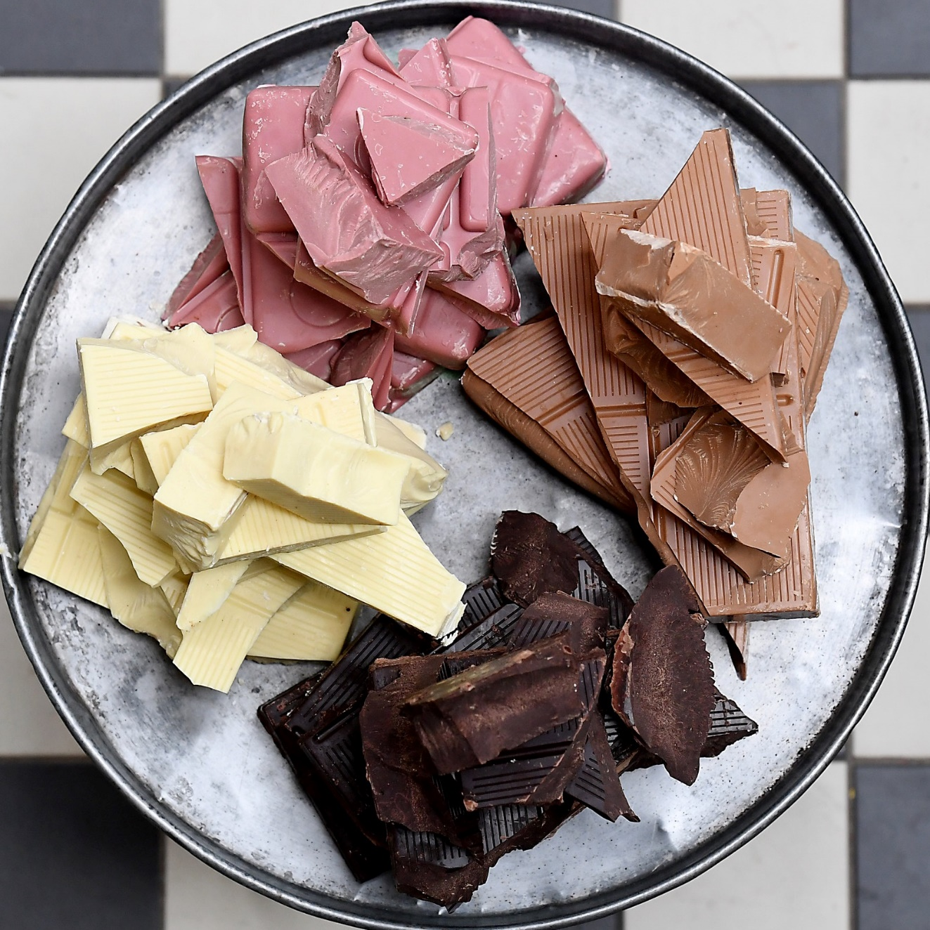
Types of Chocolate
Ruby chocolate
Milk chocolate can be further classified as
Crumb chocolate
Non-crumb (powder) chocolate
Milk chocolate
White chocolate
Dark chocolate
barry-callebaut.com
Notes:
Nowadays, there are 4 types of accepted chocolate, even though they may not all be officially recognised as such. We are all familiar with dark, milk and white chocolate, but in the past few years ruby chocolate has also been introduced by a Belgian company called Barry Callebaut. The differences between these types of chocolate are discussed in later slides.
Milk chocolate can be further classified as crumb chocolate and non-crumb, or powder, chocolate. Again, these are described in later slides.

Slide 7
Differences in the Types of Chocolate
Chocolate | Cocoa Butter | Non-fat Cocoa Solids | Milk Fat | Non-fat Milk Solids
Dark | ✓ | ✓ | ? | -
Milk | ✓ | ✓ | ✓ | ✓
White | ✓ | - | ✓ | ✓
Ruby | ✓ | ✓ | ✓ | ✓
Notes:
All 4 types of chocolate must contain cocoa butter.
Dark chocolate (or as it is officially known, chocolate) however cannot contain non-fat milk solids (top right), or in other words, skimmed milk powder. This stands to reason as it’s not a milk chocolate. What is interesting however is that can contain milk fat (butter) (top, second from right). This can be added for flavour and texture, and still be classified as a dark chocolate.
White chocolate cannot contain non-fat cocoa solids (second from left, second from bottom), commonly known as cocoa powder, which again is a bit obvious.
Ruby chocolate however does contain cocoa powder, and yet looks pink, not brown. This is because the way the beans are processed makes the powder actually have this pinkish-reddish colour.

Slide 8
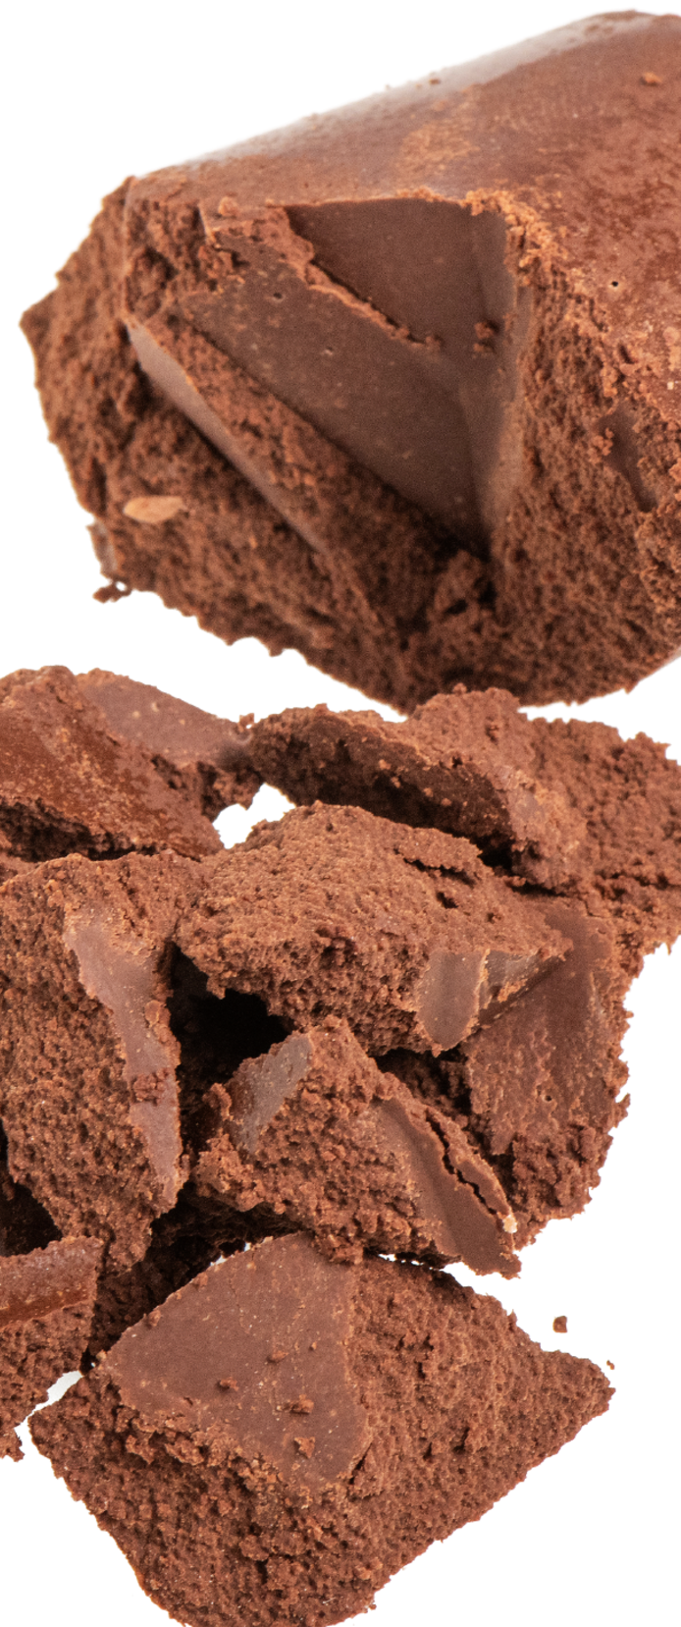
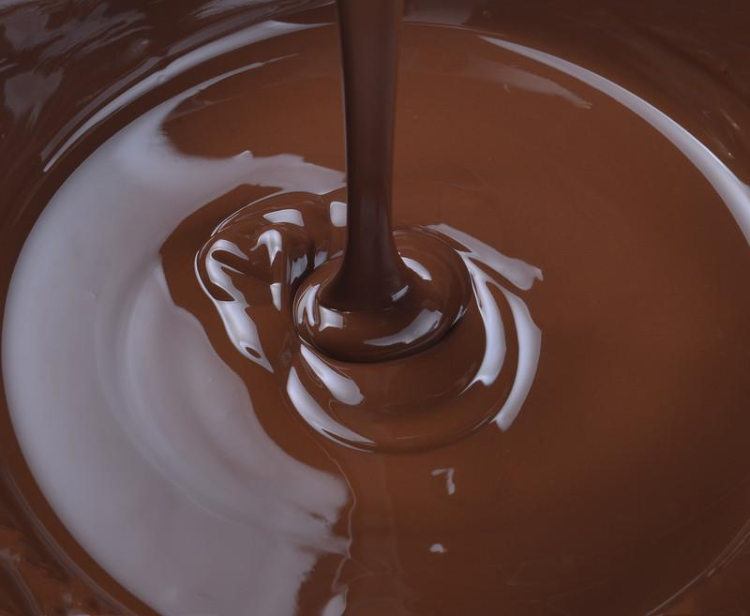
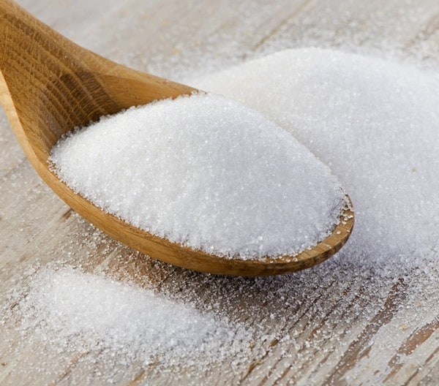
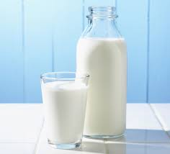
Crumb Chocolate
Crumb is made by cooking together cocoa liquor/mass (cocoa butter + cocoa powder), sugar, and milk, until a dry product is obtained
This cooking process induces caramelisation and the Maillard reaction, giving crumb chocolates their distinctive flavour
cocoasupply.eu
kinder.com
bbcgoodfood.com
buhlergroup.com
Notes:
Crumb is the product obtained when cocoa liquor/mass (the product obtained when pressing roasted cocoa beans or nibs), sugar and milk are cooked until most of the water has been removed. This was a technique developed in the 1870 s in Switzerland to be able to produce milk chocolate all year round. Milk was only available for a number of months every year, so the options were either to stop making milk chocolate or use sour milk. By making crumb, the milk was “preserved”, while also ensuring a supply of crumb to make chocolate at any time.
Crumb-making involves a lot of chemistry, as the high temperatures involved in making crumb means that the added sugar starts to caramelise, while reactions between amino acids and lactose from the milk develop “cooked” flavours (the Maillard reaction).
For an older audience: Given that the Maillard reaction requires a reducing sugar, apart from the proteins, to occur, the lactose is crucial as it is a reducing sugar, while sucrose is not. Different processing conditions (temperature and pressure) will also produce a different flavoured crumb, as the rate of the many reactions occurring will change. When cooking crumb, agglomerates are formed consisting of the constituent components, which then need to be physically broken down again and refined to make chocolate.
Crumb thus has all of the ingredients required for a milk chocolate – cocoa butter and cocoa powder (from the cocoa liquor), milk fat and non-fat milk solids (from the milk). The fat content is however still too low, and hence more fat (cocoa butter) must be added to make a chocolate bar.

Slide 9
Non-Crumb Dark/Milk Chocolate
Made from
cocoa powder (probably defatted or partially defatted)
cocoa butter
sugar
milk powders (if making milk chocolate – generally skimmed milk powder)
milk fat (depending on the chocolate)
Notes:
Non-crumb chocolate, sometimes known as powder chocolate, is made differently. In this case, the individual ingredients are not cooked together, but mixed and refined, and then more fat is added. The word powder doesn’t refer to a powdery texture or mouthfeel, but the fact that cocoa powder and milk powder and sugar (a kind of powder in itself) are used to make this type of chocolate.

Slide 10
How does Chemistry come into all of this?
Notes:
Let’s get a bit deeper into the chemistry of all of this.

Slide 11
Chemistry happens all throughout the chocolate-making process – from bean to bar
Flavour precursor development
Flavour and colour development (Maillard reaction)
Flavour refinement + addition of emulsifiers for viscosity control
Fat bloom formation (control)
Growing conditions
Fermentation of cocoa beans
Roasting of beans/nibs
Crumb-making
Chocolate making
Chocolate tempering
Chocolate storage
Eating
Flavour precursor development + formation of acids
Flavour and colour development (caramelisation and Maillard reaction)
Fat crystal formation and polymorph control
Flavour release and mouthfeel
Notes:
Enjoying a chocolate bar is only that last step of a long sequence of processes, starting from the growing of the cocoa beans to actually eating it. Cocoa beans need to be grown, then harvested, fermented and dried. The beans are then roasted, and can then be used to make chocolate crumb or pressed to make cocoa liquor and cocoa powder. The crumb or the powder, along with the cocoa butter are then used to make chocolate. To mould melted chocolate it needs to be tempered, then cooled and stored, after which it can finally be eaten as a bar.
There is chemistry happening in all of these processes, even ones you may not think of as obvious. The growing conditions – the soil, climate, rainfall, cocoa tree variety – all have an impact, as they may lead to different flavour precursor molecules being generated. Flavour precursor molecules may be flavourless themselves, but are broken down into flavour molecules later on, especially during fermentation and roasting.
Fermentation indeed starts to break down these flavour precursor molecules into fruity flavours, as well as producing acids, and other flavour precursors.
During roasting, due to the temperature involved, more of the flavour precursors are broken down, while a lot of roasted and nutty flavours are generated as a result of the Maillard reaction.
We’ve already discussed crumb-making, and the caramelisation of the added sugar, and the “cooked” flavour development between the reaction of lactose (a sugar naturally present in milk) and proteins (mostly from the milk).
During chocolate making there is a lot of flavour refinement, such as removal of the acids to make the chocolate taste less sour, addition of flavours such as vanilla. There is also other chemistry happening when emulsifiers are added to reduce the viscosity of the chocolate.
To have a shiny chocolate bar which has a good “snap” the melted chocolate must be tempered, which means that we need to delve into the chemistry of fat crystal formation and polymorph control.
There is chemistry also happening during storage, where a chocolate manufacturer tries to control the appearance of fat bloom, that harmless whitish haze on the surface of the bar.
Finally, munching on a piece of chocolate takes us to explore the chemistry of flavour release and mouthfeel.
In this session we’ll be focusing on the last three, including an interactive session at the end.

Slide 12
Chocolate Tempering and
Crystal Polymorph Control
Notes:
Let’s start off by delving a bit deeper into what are crystal polymorphs and chocolate tempering.

Slide 13
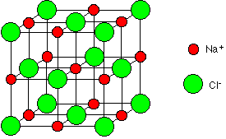
What are crystals and different polymorphs?
chemguide.co.uk

Slide 14
Cocoa Butter is Polymorphic
This means that the molecules of cocoa butter can be stacked together in different ways.
There are 6 accepted polymorphs (or forms) of cocoa butter, although there are probably a number of intermediates ones as well – the desired polymorph is called Form V.
Notes:
This means that different polymorphs are actually a result of how the molecules making up cocoa butter stack together, depending on how the cocoa butter is handled.
There are 6 accepted polymorphs, or forms, of cocoa butter, although there are probably a number of intermediate ones too. To get a nice and shiny bar, the manufacturer aims for Form V cocoa butter.

Slide 15
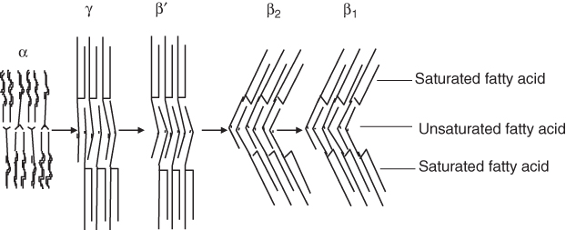
The different polymorphs of cocoa butter
Form II III IV V VI
adapted from Rajah (ed.) Fats in Food Technology 2nd ed.

Slide 16
Polymorphs of Cocoa Butter
Form | Melting Point (°C) | Description & Properties
I | 17.3 | Soft and crumbly Formed by very rapid cooling of melted chocolate Will recrystallise spontaneously from the lower to upper forms
II | 23.3
III | 25.5 | Firm, but don’t snap Formed by improper cooling of melted chocolate Will recrystallise spontaneously from the lower to upper forms
IV | 27.3
V | 33.8 | Shiny, smooth texture, good snap and melts in the mouth Stable (but not most stable) form
VI | 36.3 | Hard and melts slowly in the mouth Forms spontaneously during storage
Increased Stability and Density
compoundchem.com
Notes:
As can be seen from the table, going from Form I to VI, the melting point increases with increasing form. (For an older audience: this means that the polymorphs are more thermodynamically stable. In fact, going from Form I to Form VI, cocoa butter is crystallised in the sub-alpha, to alpha to beta-prime to beta forms, and in turn sub-forms of these. Form V is a beta-2 crystal, while Form VI is a beta-1 crystal).
Having such a low melting point when it’s in Forms I and II, means that the chocolate is very soft and crumbly, and will spontaneously try to go to a more stable, and higher melting point, crystal forms.
Chocolate in Forms III and IV is firmer, but is still dull and doesn’t snap, and will also try and re-crystallise to the more stable Form V.
Form V is the stable form that manufacturers strive for, although it is still not the most stable. Form V also melts at around 34 °C, which means that it melts when put in the mouth, which makes for a very nice eating experience.
Manufacturers can’t make the most stable form, Form VI, directly. This only forms spontaneously during storage, albeit very slowly (in the order of months). Form VI cocoa butter is also very hard and melts slowly in the mouth, so as a manufacturer you would actually want your chocolate to stay in Form V.

Slide 17
Chocolate tempering
Tempering is the process where chocolate is melted then cooled down in a controlled process to make sure that the finished chocolate is shiny and snaps.
This is important because cocoa butter is polymorphic – this means that the crystals formed when cocoa butter is cooled down can take various forms.
Notes:
What is tempering? Tempering is the process where chocolate is melted then cooled down in a controlled manner. This is important because if chocolate is not tempered correctly it doesn’t end up having a nice shiny surface and a good snap, which we all look for when buying and eating chocolate.
Why is this important? Cocoa butter is polymorphic, which means that not only do crystals form when cocoa butter is cooled down and changes from liquid to solid, but it can also form different “forms” of crystals when it cools. Which “form” it crystallises to depends on how it is cooled down.

Slide 18
Tempering Chocolate
50
Fully melted chocolate
45
40
35
Properly tempered liquid chocolate (only Form V)
Temperature (°C)
30
25
Properly tempered solid chocolate (only Form V)
20
Form multiple polymorphs (over-cooling) then melt out the undesired polymorphs
15
Solid chocolate
Time
adapted from
McGee, On Food and Cooking

Slide 19
Tempering Chocolate
50
Fully melted chocolate
Method 1 – commonly used at home
45
40
Seed chocolate with Form V cocoa butter or chocolate (Method 1)
35
Properly tempered liquid chocolate (only Form V)
Temperature (°C)
30
25
Properly tempered solid chocolate (only Form V)
20
Form multiple polymorphs (over-cooling) then melt out the undesired polymorphs (Method 2)
15
Solid chocolate
Method 2 – commonly used in industry
Time
adapted from
McGee, On Food and Cooking
Notes:
There are two methods to temper chocolate, both involving the careful control of the temperature of the chocolate.
Starting with solid chocolate, it needs to be melted out completely by heating to 45-50 °C. At this temperature the cocoa butter molecules are completely disordered, shown by non-aligned grey molecules.
You then have two options, shown by the solid line and dashed line. If you choose to follow the solid line, once the chocolate has been melted out fully, you then cool it again to around 33 °C, at which point you “seed“ that melted chocolate by adding chocolate or cocoa butter which has already been tempered to contain only Form V seeds. Why is the temperature important? If the “seeds” are added at a high temperature, then the “seeds” would melt out. At a lower temperature you start going into dashed-line territory, i.e. you would spontaneously start forming crystals, including unwanted forms. If you do decide to “seed” the chocolate, and follow the solid line (Method 1) at this point you’ll have some cocoa butter seeds (aligned molecules in pink) and some melted cocoa butter (grey non-aligned molecules).
If you decide to go down the dashed-line route (Method 2), you will spontaneously form cocoa butter crystals, however these will be of different forms (shown as blue and pink), which include undesired forms. You thus have to re-heat the chocolate to melt out the undesired crystal forms, as the undesired crystal forms have a lower melting point, as we saw previously.
Using either method, you end up with properly tempered liquid chocolate, i.e. all the crystals present is in Form V, however not all of the fat crystals are crystalline yet, and hence the chocolate is still liquid, if quite thick.
On letting the chocolate set, the crystals act as templates for the liquid fat molecules, which means that the liquid fat crystals stack on top of the crystallise fat molecules. This leads to the chocolate turning solid.
Which method is used is irrelevant, as long as you’re careful with the temperatures used, as both mean that you end up with well-tempered chocolate. In generally, however, Method 1 is commonly used at home, where one would add grated chocolate to melted chocolate.
Method 2 is the preferred method of chocolate manufacturers and chocolatiers.

Slide 20
Fat Bloom (and Control)
Notes:
Moving on from tempering, and the chemistry of crystallisation from melts, to a different crystallisation phenomenon, that of fat bloom, and how to control it.

Slide 21
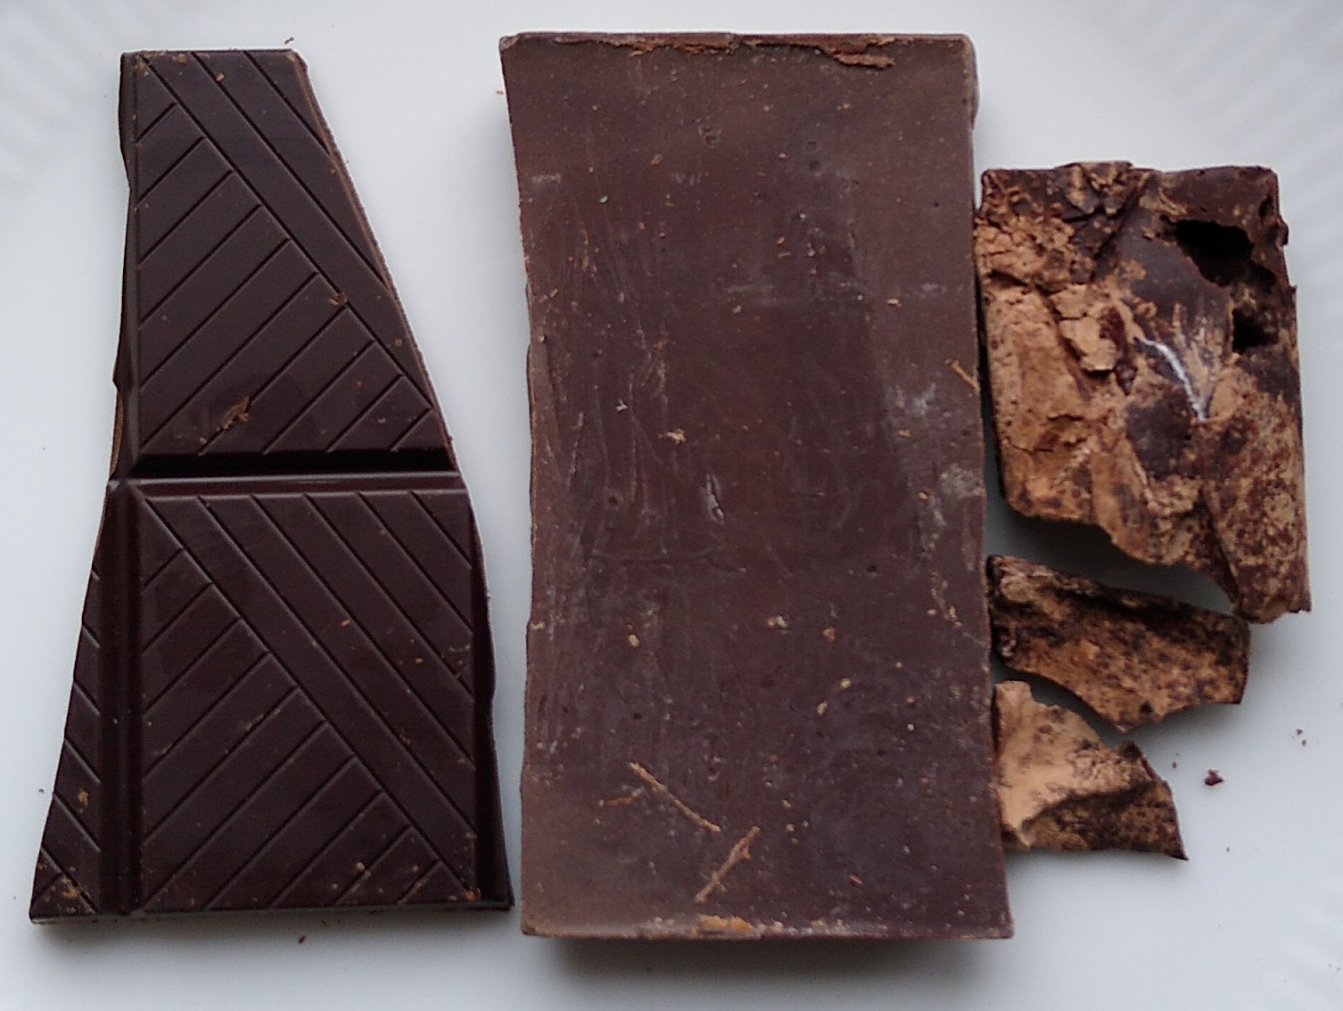
What is fat bloom?
Well tempered dark chocolate
Heat abused dark chocolate
Ever opened a chocolate bar and found that it’s covered in “fuzz”, or it looks pale and patchy?
It usually puts people off as it tends to look a bit like mould, although there is nothing mouldy, or harmful, about it.
Bloomed dark chocolate (spontaneous)
Notes:
First of all, what is fat bloom? Fat bloom is usually observed as a “fuzz” on the chocolate surface, or it has patches which are pale and others which are dark.
For an older audience: fat bloom is actually seen because the fat crystals are so irregular and large that they scatter light, which shows up as a pale colour.
As you can see in the picture, on the left you have a well-tempered dark chocolate. It’s shiny, and you can “hear it” snap. In the middle you can see a bloomed dark chocolate, with a pale surface. This is the type of bloom that happens spontaneously with time. (For an older audience: this is generally a result of Form V cocoa butter re-crystallising to Form VI, i.e. the more thermodynamically stable form of cocoa butter). On the right you can see a dark chocolate which has been thermally abused, i.e. it’s been left in the sun, which has caused it to melt and re-crystallise (re-solidify) on its own.
Bloomed chocolate tends to put people off as it can look a bit like mould. There is however nothing mouldy or harmful about bloomed chocolate in any way. it may just not feel as pleasant in the mouth.
The causes for these two types of bloom are different, but they are both due to the uncontrolled crystallisation of fat crystals.

Slide 22
How does fat bloom occur?
Fat crystal recrystallisation on long-term storage
Chocolate has not been tempered correctly
When it happens spontaneously, it can occur for a number of reasons
Fat migration from a filling to the surface of the chocolate
Temperature cycling or temperature abuse
Notes:
When fat bloom occurs spontaneously, i.e. not because it’s been left in the sun, it can occur for a number of reasons.
As shown in the previous slide, as in the middle chocolate, you can get spontaneous fat crystal re-crystallisation if you leave it in the cupboard for too long.
As we also saw earlier, less stable forms will want to transform to a more stable form. This means that a chocolate which has not been tempered properly will want to reach Form V, and this recrystallisation from lower Forms to form V shows up as bloom, usually as a lot of paler streaks or a blotched appearance.
Fat migration from a filling, or nut inclusions, is a common cause of bloom. This is usually seen in dark chocolate with hazelnuts in, or pralines which are filled with a nut-flavoured filling. This causes oils from the nuts or filling to migrate to the surface of the chocolate. These oils then interact with the fat crystals on the surface of the chocolate, again eventually causing them to re-crystallise in an uncontrolled manner.
Temperature cycling, or temperature abuse, is also another reason. This doesn’t mean that the chocolate has necessarily been melted out, as we could see in the previous slide. The chocolate may still remain solid, however the storage temperature goes up and down multiple times, which again can cause crystal instability.

Slide 23

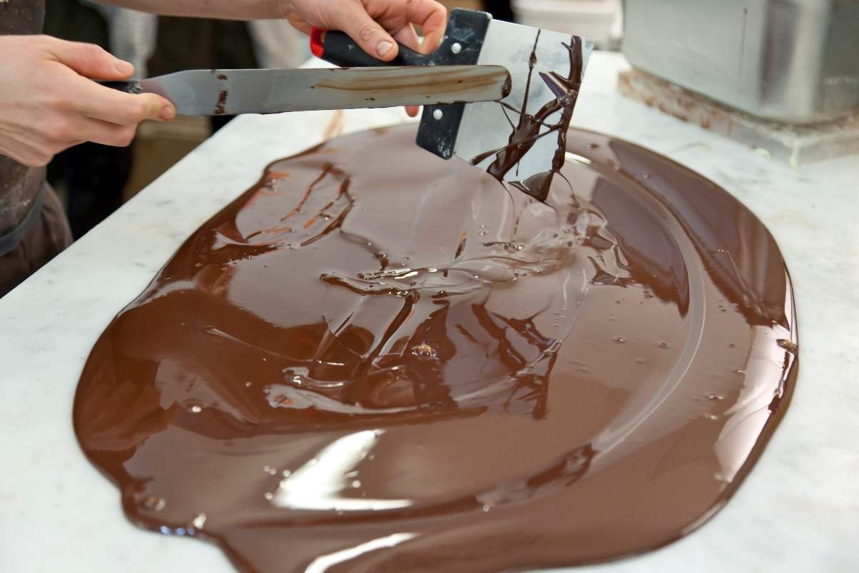
How can we prevent fat bloom developing?
Storage temperature
Tempering
Chocolate formulation
Addition of
(enough) milk fat
specific fats
Filling formulation
Use of compatible fats – no (or very little) liquid oils or even incompatible fats (such as coconut oil)
flaticon.com
greatbritishchefs.com
Notes:
We’ve already spoken about the first two things a manufacturer, and we, can do – keeping a stable storage temperature, and tempering chocolate correctly.
There is however also a lot of chemistry that can be used to prevent, or slow down, the formation off at bloom.
There’s the formulation of the chocolate itself. Adding milk fat affects not only the flavour and texture of the chocolate, but it has been shown that adding enough also slows down fat bloom formation considerably. Adding too much however will make the chocolate too soft and may actually cause fat bloom.
For an older audience: cocoa butter is mostly made up long-chain palmitic, stearic and oleic fatty acids, while it has been shown that the addition of a small proportion of medium-chain lauric fats, which milk fat contains, but cocoa butter is poor in, helps to prevent against fat bloom.
Milk fat however is not the only fat which can be used, and there are other speciality fats which can also be used.
For an older audience: this includes the rare and expensive BOB triacylglycerides (behenic-oleic-behenic, but also some specific emulsifiers, especially STS (sorbitan tristearate). It is thought that the latter caps the crystals formed, preventing any further templating, and hence the crystals can’t grow any larger, hence can’t scatter light as they aren’t large enough to do so, and hence no bloom is observed..
Finally, the filling formulation has also to be taken into consideration. If the filling is made up of too many fats which are considered “incompatible” with cocoa butter, such as liquid oils (e.g. hazelnut oil), or coconut oil (for an older audience: which is very high in lauric fats), then the interaction of these, or, in other words, their chemistry, can easily lead to fat bloom formation.

Slide 24
What Gives Chocolate its Flavour?
Notes:
Both taste (which you perceive with the tongue – sweet, salty, sour, bitter, umami)
and aroma which you perceive with the nose.

Slide 25

What is Flavour?
Flavour is the combination of taste and smell (aroma)
There are only 5 accepted basic tastes; sweet, sour, salty, bitter and umami – these are all non-volatile and are detected by the tongue
There are however possibly an unlimited combination of aromas – these are all volatile and are detected by the nose
Notes:
Further info in case there are questions
Other tastes have been identified :
• Fat taste – CD36 receptors identified which respond to fatty acids (need lipase to break down the fats)
• Kokumi – delicious, rich mouthfullness, calcium ion channels have been discovered CaSR which are activated by g-glutamyl peptides
• Metallic taste
• Water
Aroma
Our noses are more sensitive to some compounds than even the most sophisticated analytical instruments.
So what type of aromas do you expect in chocolate?

Slide 26

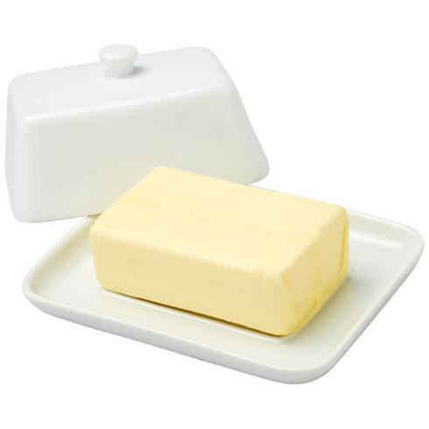
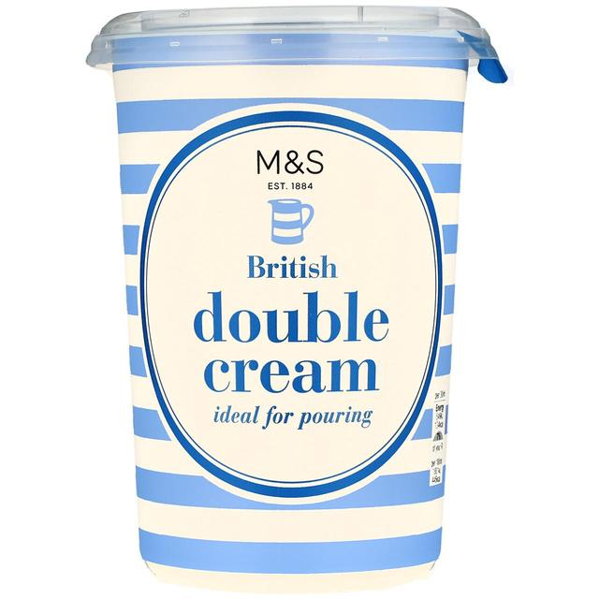

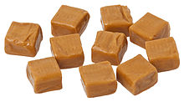
What does this one smell of?
2,3-pentanedione
Notes:
Questions for the audience
What does it smell of (without the pictures)?
Does it remind you of any of these? (with the pictures)
Usually buttery, creamy, toffee, butter popcorn, but any answer goes!
Do you expect to find it in chocolate?
If so what kind of chocolate – milk chocolate?
How many carbon atoms?
What are the functional groups?
What carbon number are they on?

Slide 27


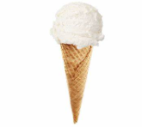
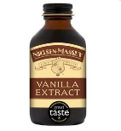
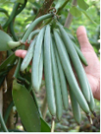
What does this one smell of?
vanillin
Notes:
Questions for the audience
What does it smell of (without the pictures)?
Does it remind you of any of these? (with the pictures)
Vanilla ice cream, vanilla icing, vanilla muffins!
It’s a delctae orchid – that’s why there is a flower
Do you expect to find it in chocolate?
Yes, its very commonly added to chocolate
And the green beans – that’s what vanilla looks like before it is “cured”
Curing is a fermentation.

Slide 28

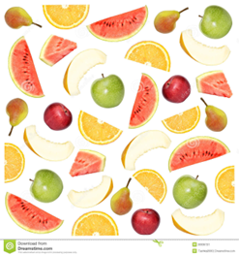
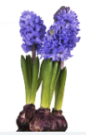

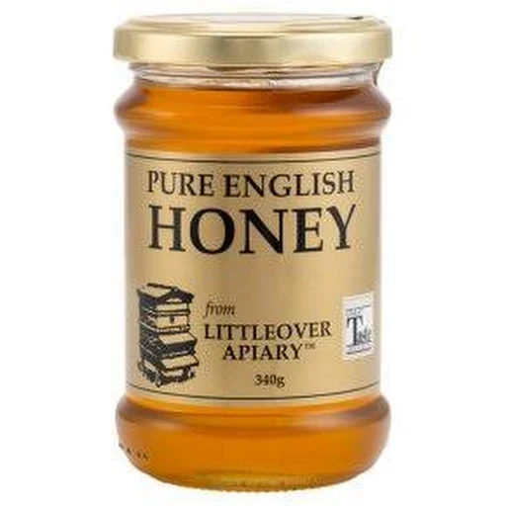
What does this one smell of?
Phenylacetaldehyde
Notes:
Questions for the audience
What does it smell of (without the pictures)?
Does it remind you of any of these? (with the pictures)
Usually sweet floral fruity hgyacinth waxy citrus but any answer goes!
Do you expect to find it in chocolate?
If so what kind of chocolate – some milk chocolates have a rosy note in them.
What is the name of the ring?
What class of compounds does it belong to?
How many carbon atoms?

Slide 29

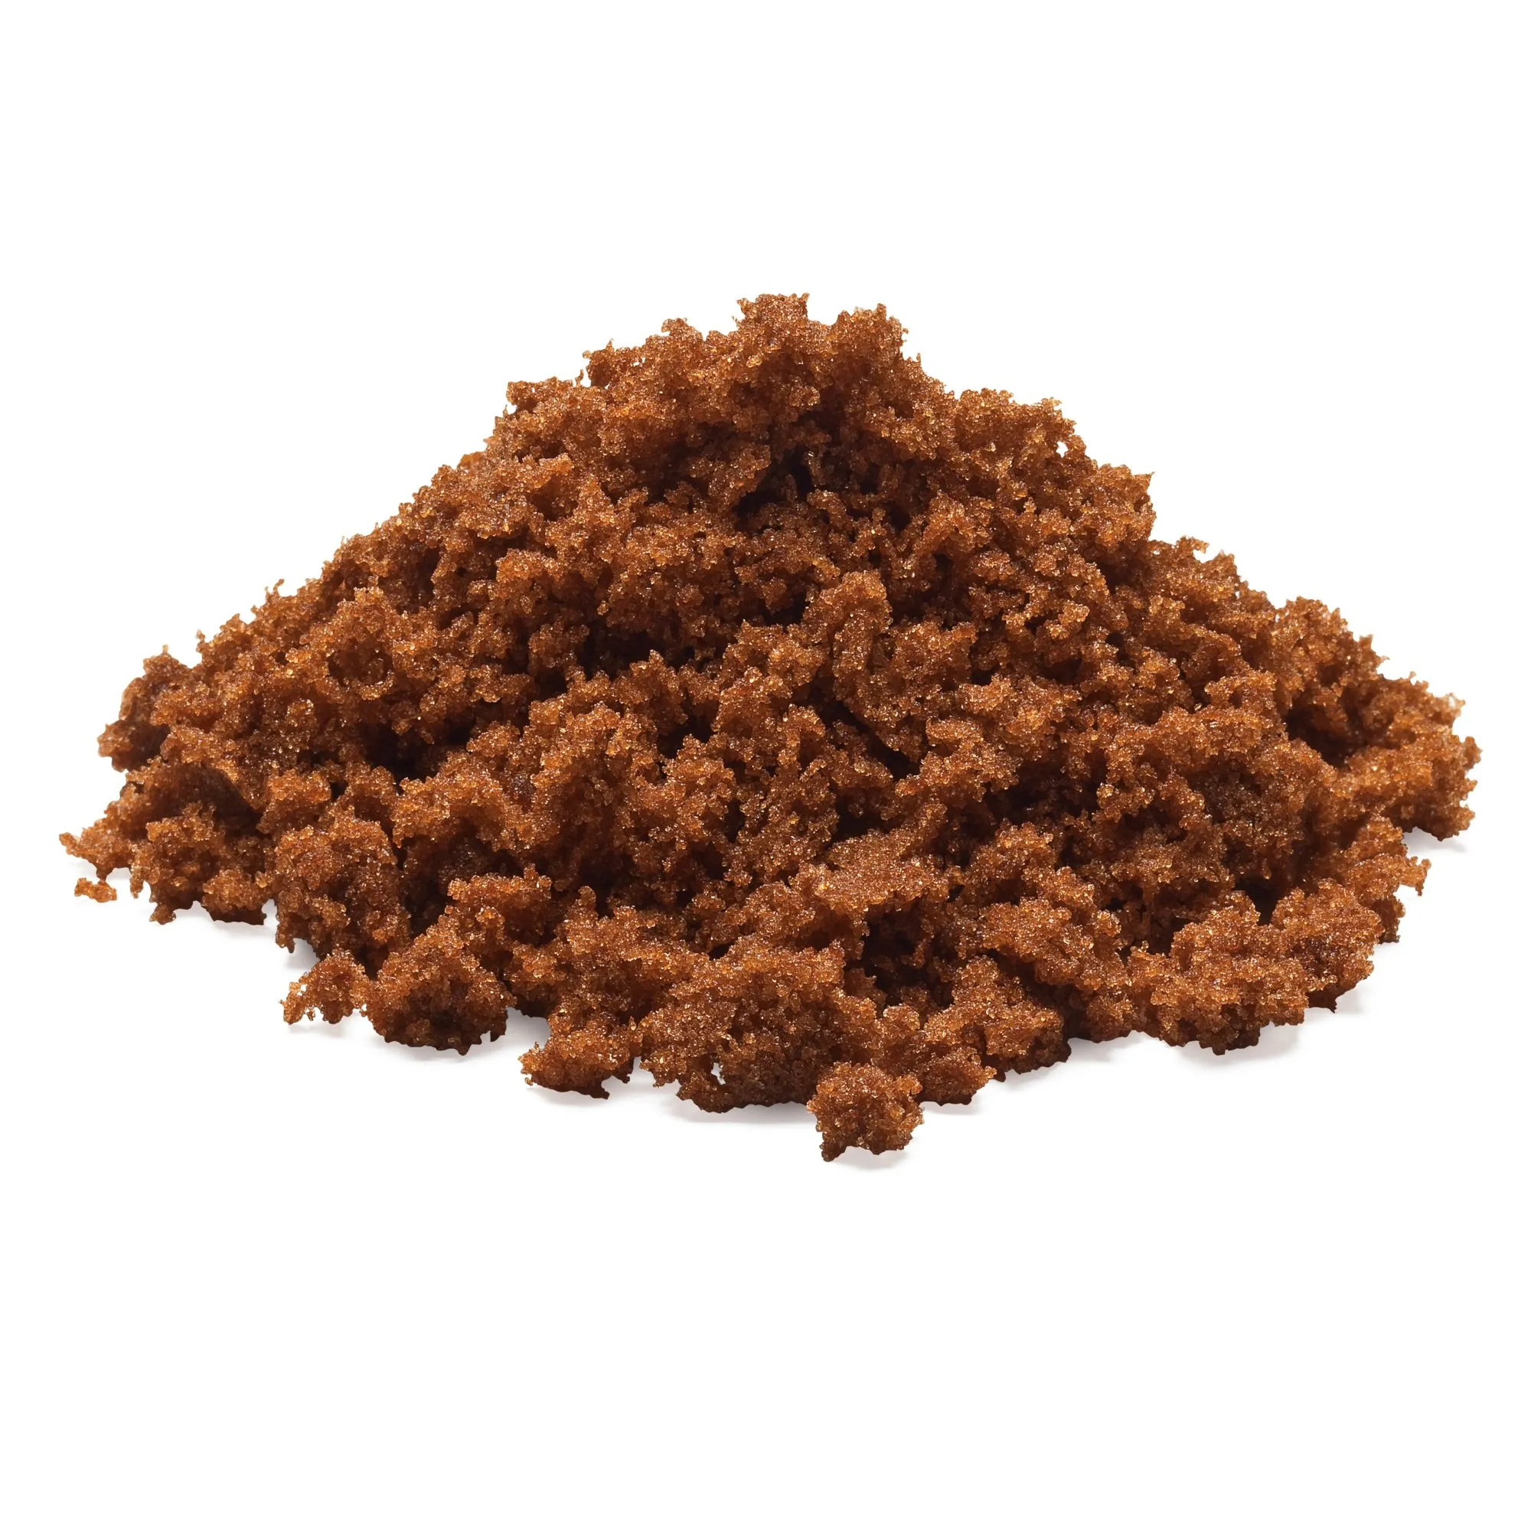
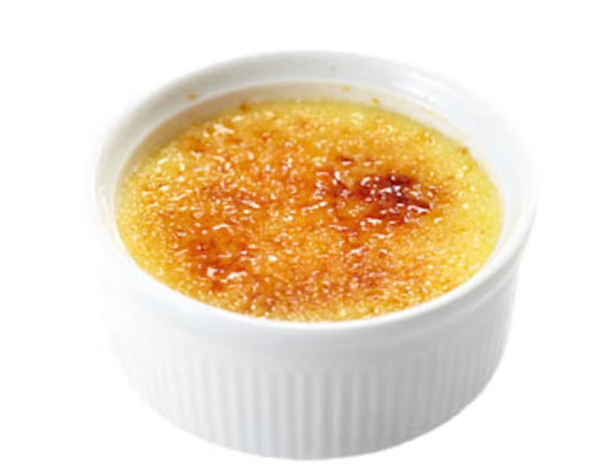
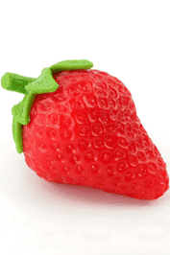
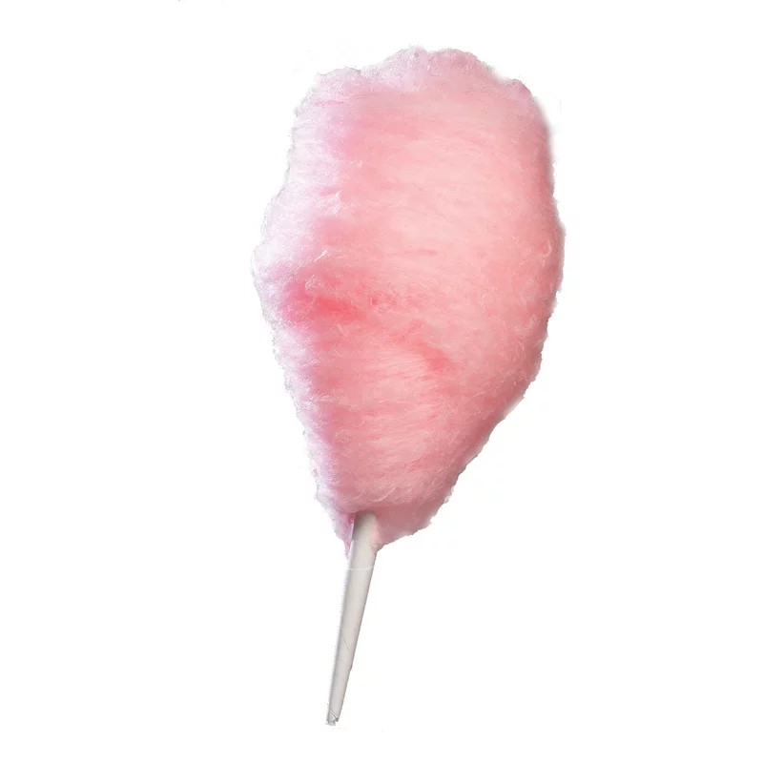
What does this one smell of?
4
furaneol
Notes:
Questions for the audience
What does it smell of (without the pictures)?
Does it remind you of any of these? (with the pictures)
Usually extremely sweet strong caramel maple burnt sugar coffee candy floss?
Do you expect to find it in chocolate?

Slide 30
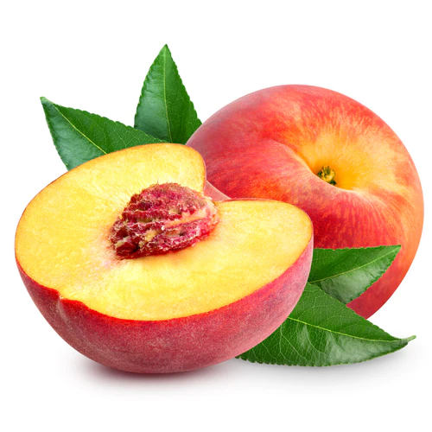
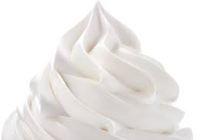
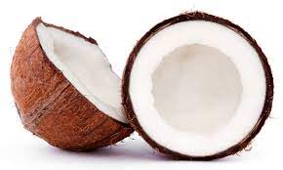
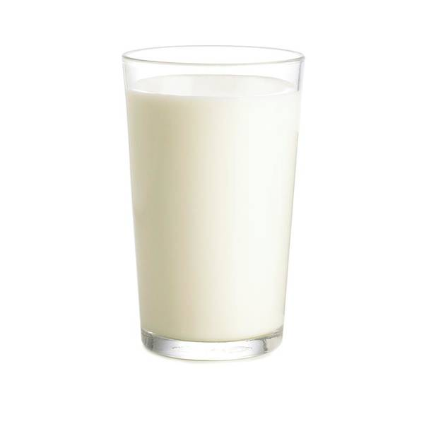
What does this one smell of?
5
δ-decalctone
Notes:
Questions for the audience
What does it smell of (without the pictures)?
Does it remind you of any of these? (with the pictures)
Usually fruity, peachy, tropical?
Do you expect to find it in chocolate?
Not really, but it contributes to the overall aroma
You can point out for some audiences that it is in fact an ester (internal ester) or lactone

Slide 31

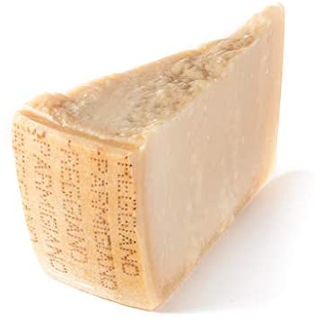

What does this one smell of?
3-methylbutanoic acid
Notes:
Questions for the audience
What does it smell of (without the pictures)?
Does it remind you of any of these? (with the pictures)
Usually cheese, parmesan,
Does anybody get a vomity note?
Do you expect to find it in chocolate?
No, but incredibly important component of chocolate flavour

Slide 32
Thank you

Slide 33

We would love to hear your feedback
We would really appreciate it if students could please scan the QR code and fill in the online form to give their feedback
Scan Me

Slide 34

Teachers we would also love to hear your feedback
Teachers, we would really appreciate it if you could please scan the QR code and fill in the online form to give your feedback
Scan Me

