Slide 1
SAFETY INFORMATION
There is inherently very little risk associated with handling very small quantities of these chemicals.
All samples are used on a regular basis to prepare flavourings for incorporation into many food products.
They are all food grade and have not been handled in a chemistry or microbiology lab.
We recommend that they are dispensed in a fume cupboard if there is one available, otherwise use a well-ventilated room.
We recommend that you wear PPE whilst dispensing (labcoat and safety goggles) as very occasionally there are skin sensitivities.
We recommend that you store in a spark-proofed fridge.
They contents can be disposed of down the sink, flushed with plenty of water and the eppendorfs and used smelling strips should be sealed in an empty water bottle or ziplock bag prior to disposal as the smell can linger.

Slide 2

2,3-Pentanedione safety sheet

Slide 3
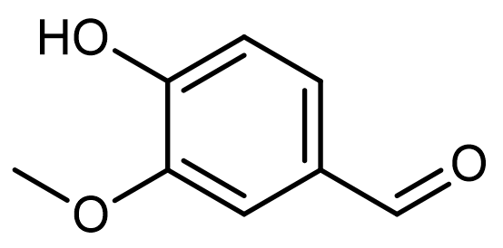
Vanillin safety sheet

Slide 4
Phenylacetaldehyde safety sheet

Slide 5
Furaneol safety sheet

Slide 6
δ-Decalactone safety sheet

Slide 7
3-Methylbutanoic acid safety sheet

